Slide 1

CO326 Project
Smart Building
Group C - Safety

Slide 2
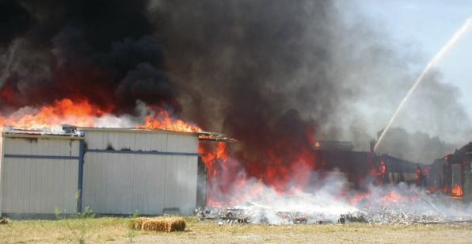
Introduction
Safety is an important part of Smart building system.
So many safety issues for a building.
Developed a prototype system to detect the fire.
According to statistics from the China Commercial Fire and Safety Association in 2019, a total of 233,000 fires and 1,335 people died.
Notes:
Nowadays, fire is a common serious problem faced by countries all over the world.
While causing casualties, it will also bring certain property losses and adverse socio political effects. According to statistics from the China Commercial Fire and Safety Association in 2019, a total of 233,000 fires
were reported across the country, 1,335 people died, and direct property losses reached 3.612 billion yuan.

Slide 3
Problems
Detecting fire
Informing the details to every floors and rooms
evacuating people in priority order
Finding suitable path for evacuation
Managing path traffic when evacuating
Handling fire in automated way
Prevention of failure in the system
Way of handle in failure of the system

Slide 4
Solutions
Detecting fire using sensors and image processing
Use notification appliances
Audible - fire alarm, voice announcement
Visual - light indications
Using vertical and horizontal evacuation techniques
Locate fire detected location ignore that path
Using Algorithms for detecting path cost
Activate sprinkler in automated way
Using fire-resistant wires and sensors
Sending Fire alert to local fire service department

Slide 5
Overview of the system
Pull station
Database
MQ2 gas sensor
Temp_status
Smoke_status
Room 1
Room 1
Fire Detector
Room 2
Room 2
Temperature Sensor
Controller
MQTT
SCADA
Web interface
Sprinker
Fire Alarm
Voice Alarm System

Slide 6
Fire Detection
Reading sensor data
Analyze received data
Conforming using image processing

Slide 7
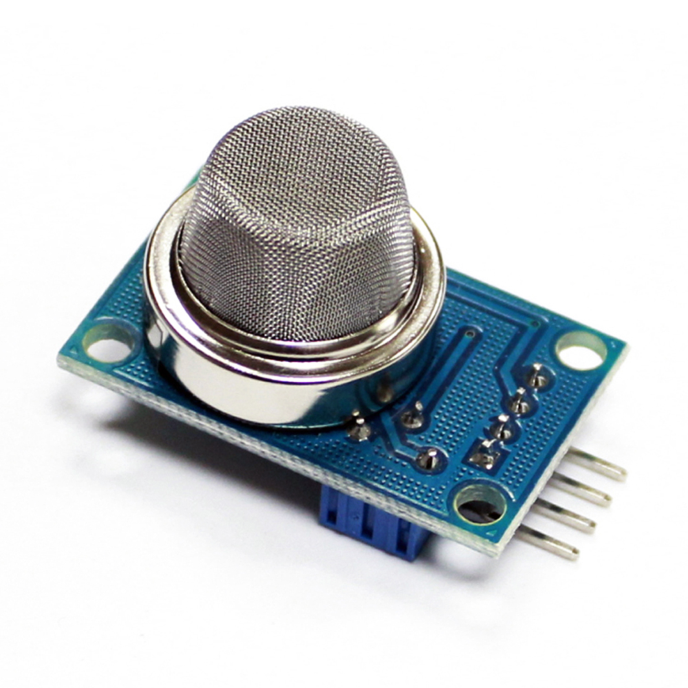
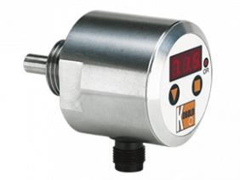
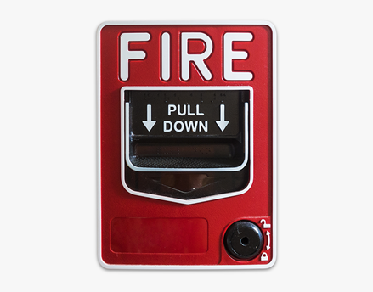
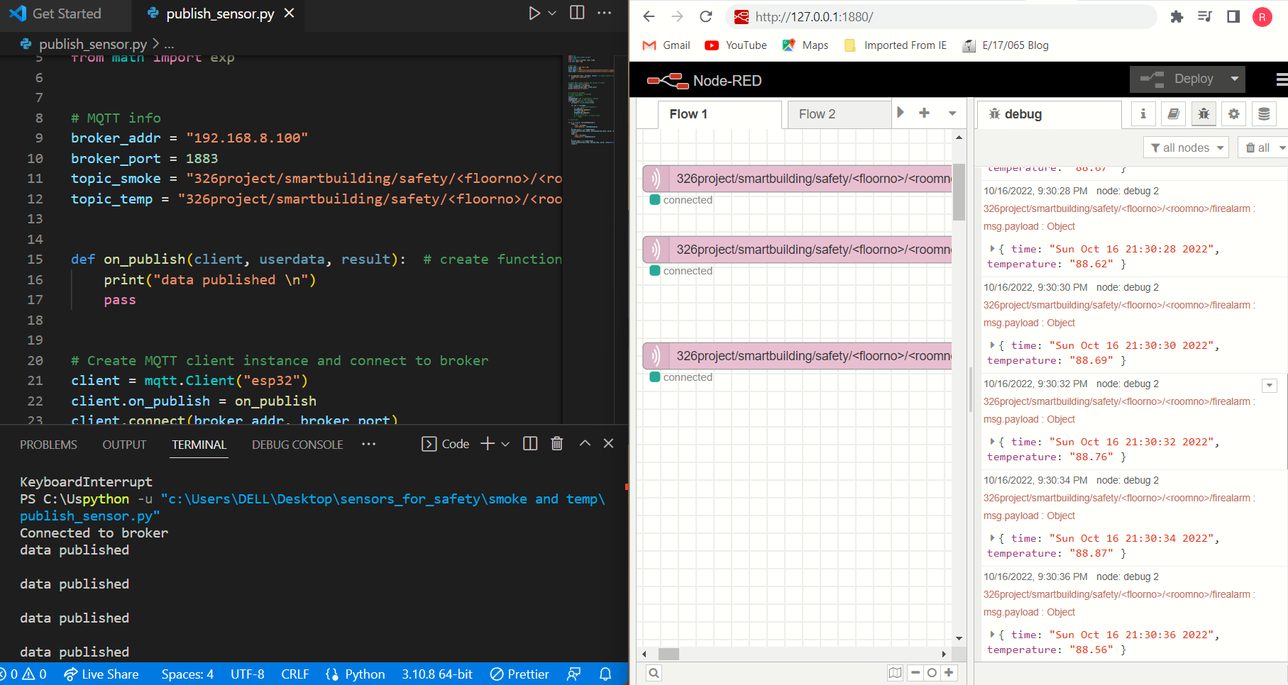
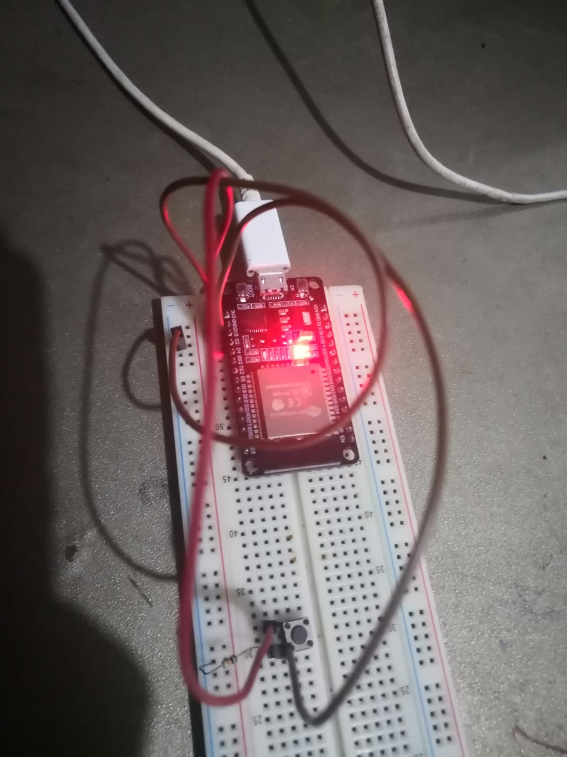
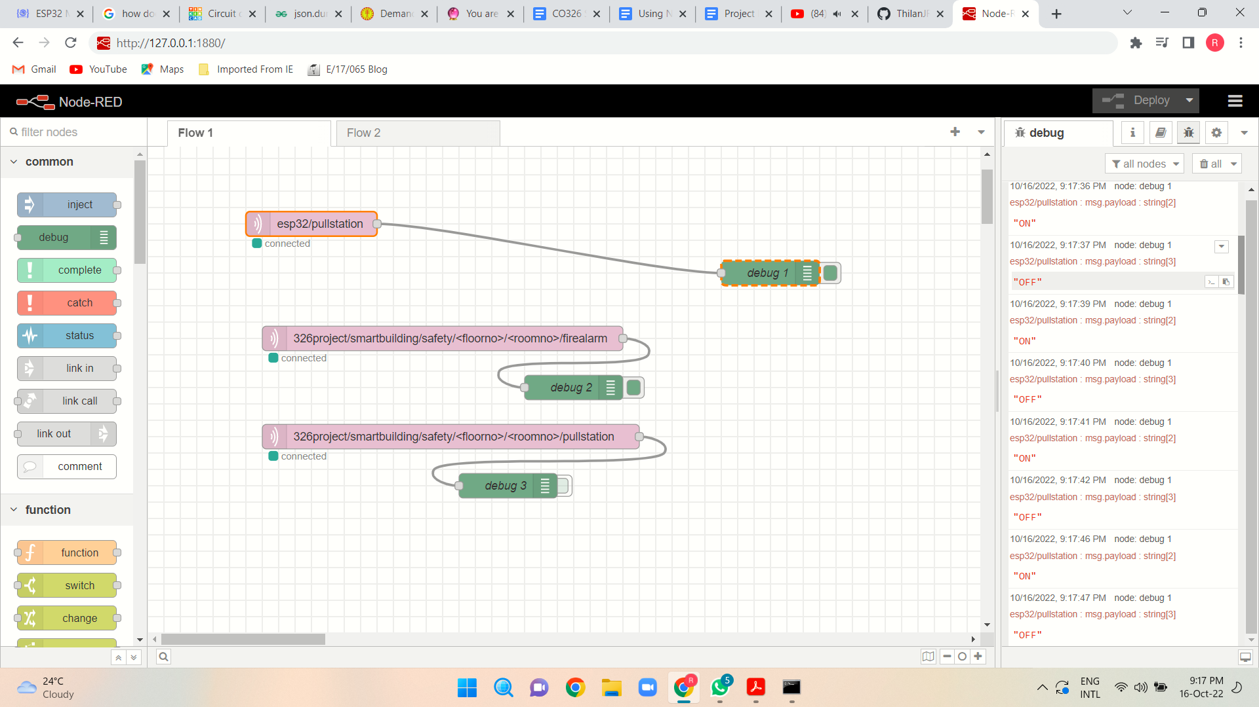
Sensors and data flow
MQ2 sensor
(detecting smoke)
TDA sensor
(detecting Temperature)
Pull Station
(Manual Activator)
Publishing Sensor Readings to MQTT

Slide 8
Sensor data flow
The overall system handles many data types. The Safety part also work with different data.
The MQTT protocol will be used to publish such data to the server. System must use the information to make the decisions.
MQTT
Subscribe Publish
MQTT Topic: 326project/smartbuilding/safety/
MQTT Server
Sensor, Controller
Scada System, Web, Database

Slide 9
The MQTT Topics Used to publish
326project/smartbuilding/safety/<floorno>/<roomno>/smoke
326project/smartbuilding/safety/<floorno>/<roomno>/fire
326project/smartbuilding/safety/<floorno>/<roomno>/sprinkler
326project/smartbuilding/safety/<floorno>/<roomno>/firealarm
326project/smartbuilding/safety/<floorno>/<roomno>/pullstation

Slide 10
Find Threshold Value
Here we use a threshold value to increase accuracy of our system.
There are two ways to find threshold value.
Static Way
Fixed temperature detectors find fire, when the room temperature is higher than the manually set point.
Rate of rise method
Calculated by anomaly detection algorithms and continuously trained by a datapoint recent historical values.
For threshold value we took mean and standard deviation from past datas.
When fires build, quickly the rate-of-rise compensation detects If the rise of temperature is nearly 15 degreesF
(8.3 C) or more per minute. using mean and standard deviation from past recent datas.

Slide 11
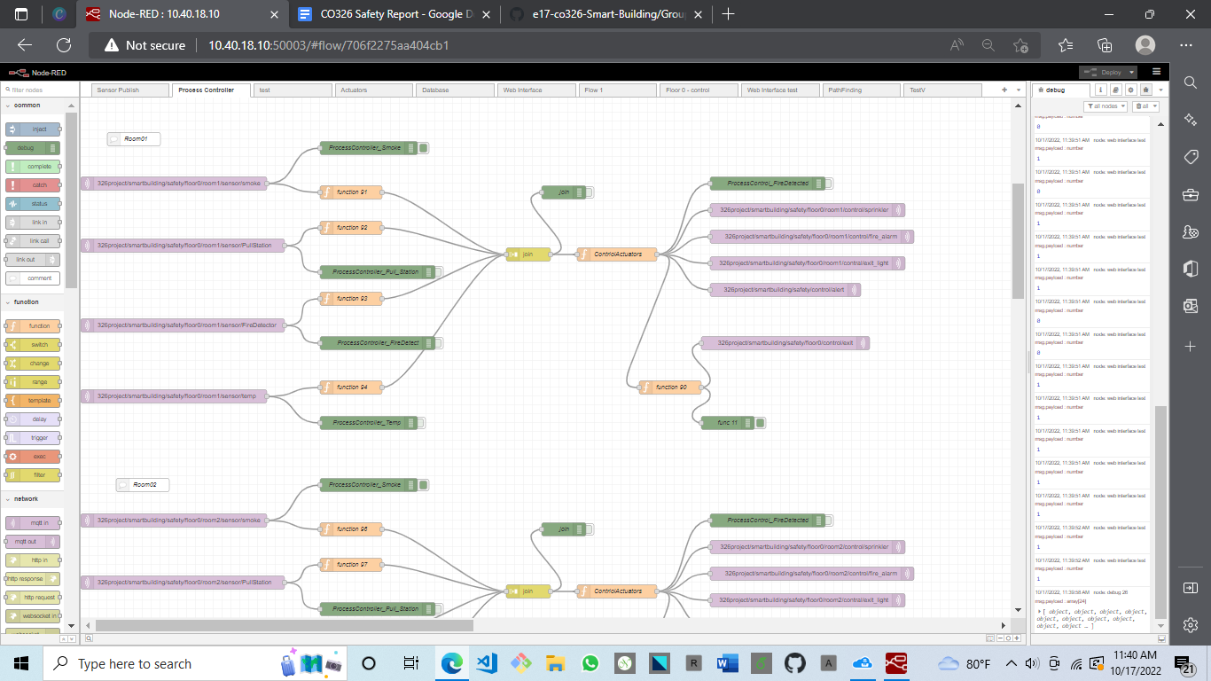
Fire detecting..
Detect fire using current smoke, temperature sensors and pull station data with the threshold value.
Controller that detect fire and publish to MQTT topic

Slide 12
Detecting Fire…
Image fire detection has recently played a crucial role in reducing fire losses in more accuracy by alarming users early through early fire detection.
Advantages of image based fire detection
Early fire detection,
High accuracy,
Flexible system installation, and the
Effectively detect fires in large spaces and complex building structures.

Slide 13
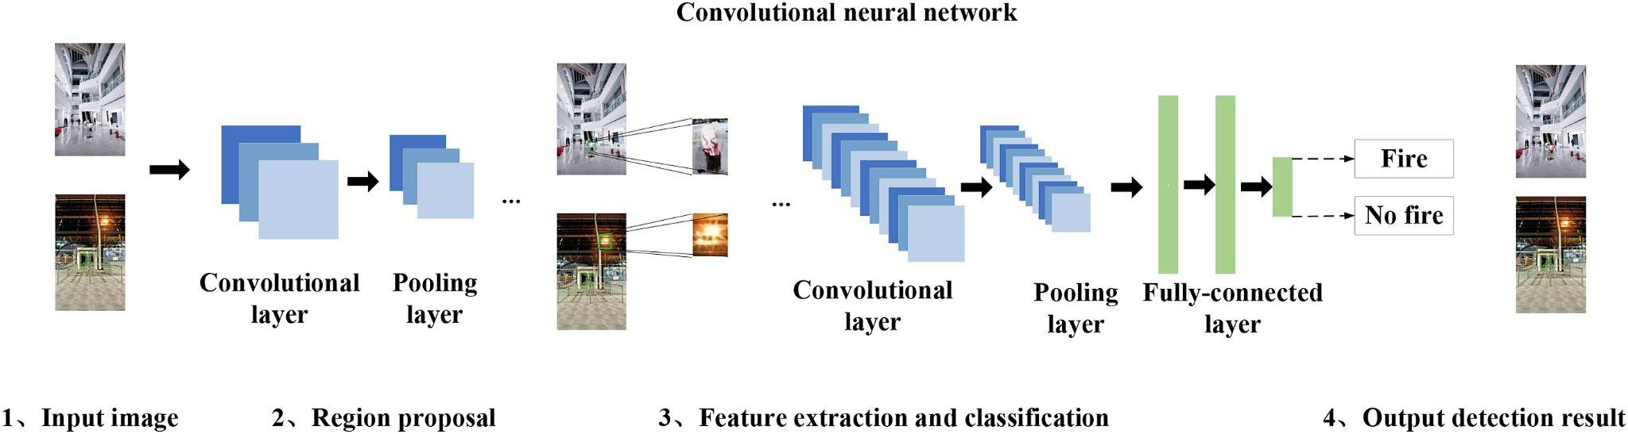
How CNN detecting fire?
We can use YOLOv3 algorithm in CNN for real time object detection and for the successful detection and warning of fire disasters through real time security cameras.
It will extract the fire region or looks like fire region from the real time video frame and classify fire or not.

Slide 14
Evacuation
Giving priority
Vertical and Horizontal Evacuation
Finding shortest path

Slide 15
Evacuation …
Techniques
Horizontal evacuation
Created a function based on Dijkstra's algorithm
Import all the relevant data from the database
Rule-based algorithm - to generate a list of nodes
that are not affected by fire
Create a new graph
Apply dijkstra’s algorithm to find the shortest path to emergency exit from each node

Slide 16
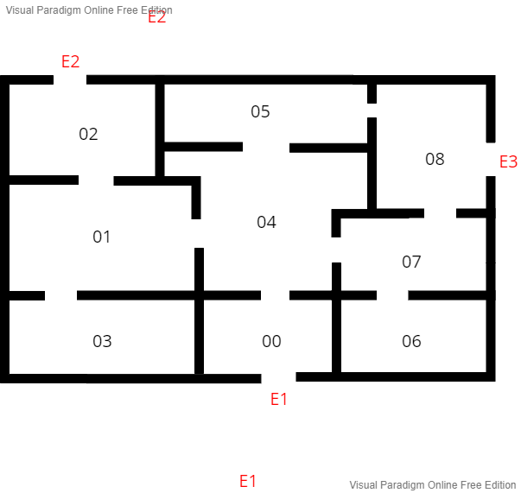
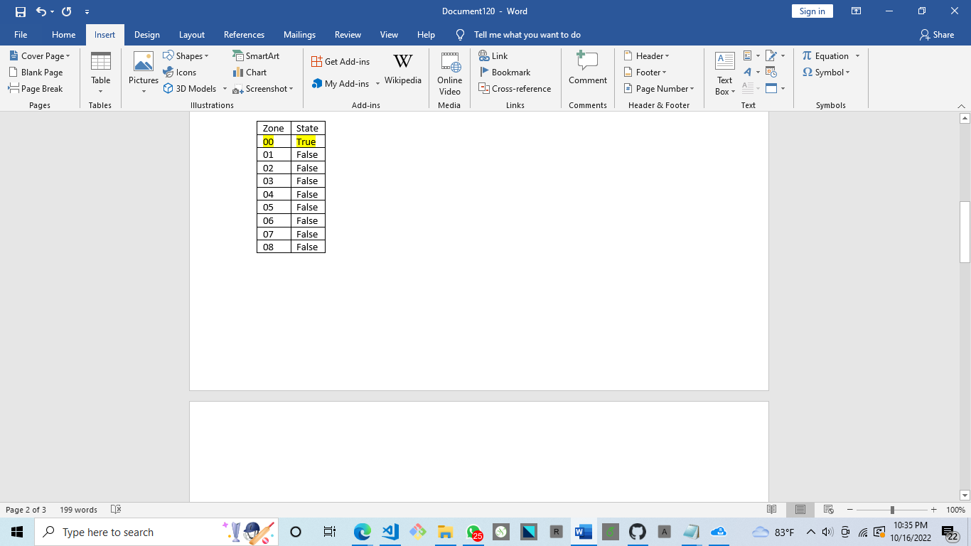
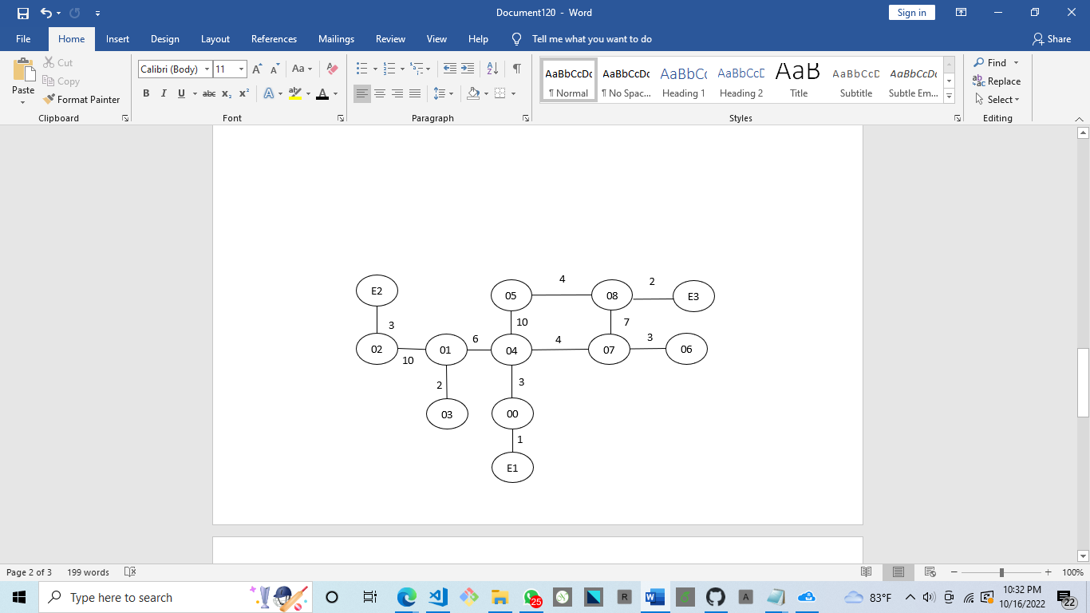
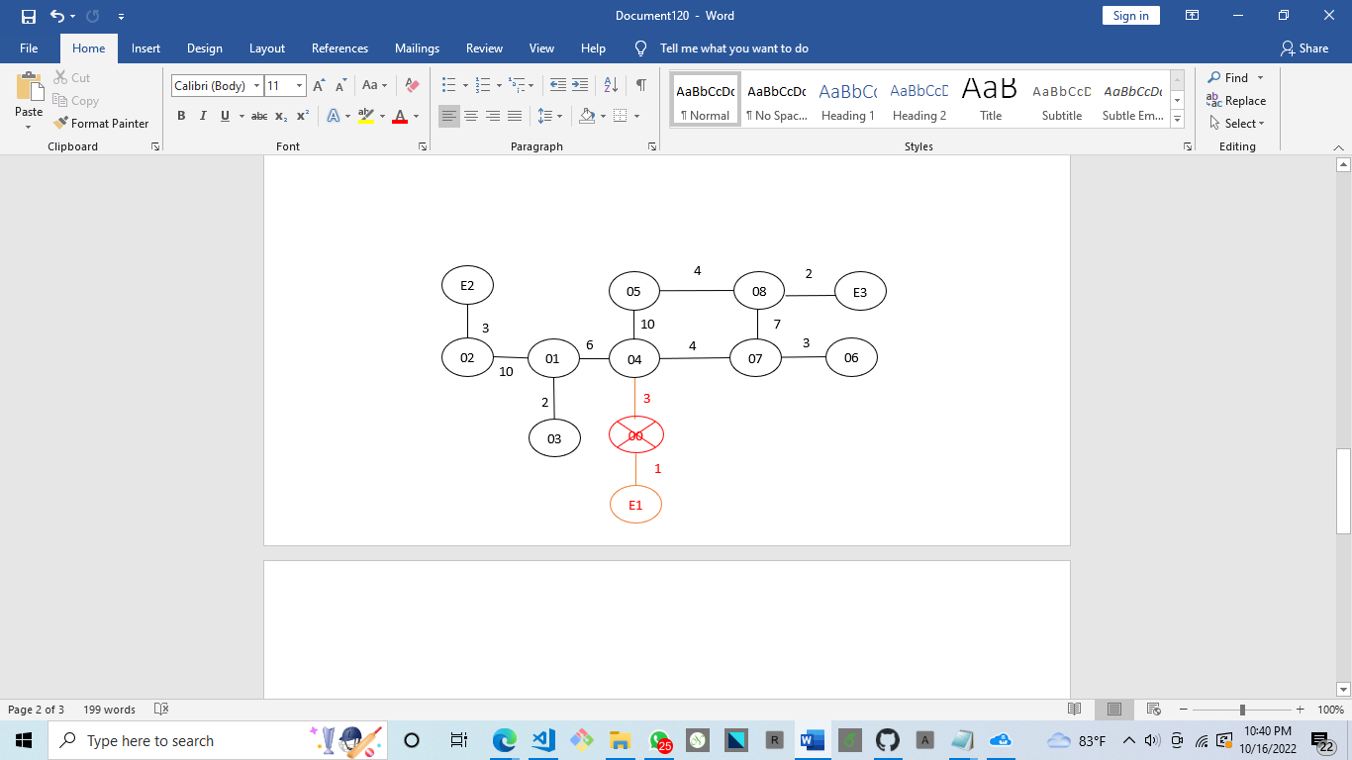
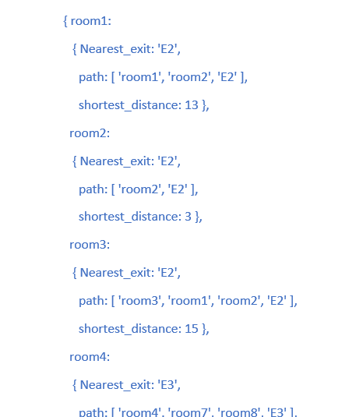
Evacuation…
Finding shortest path with available paths for horizontal evacuation
Save the status of each room to the database.
Vertical evacuation
Giving high priority to floors that above in the fire detected floor

Slide 17
Fire controlling
Using actuators
Monitoring (using SCADA dashboard)

Slide 18
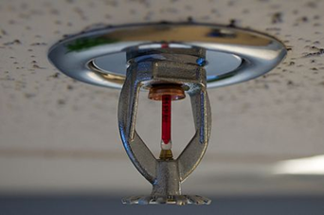
Fire controlling..
Sprinkler
Automated fire detection system activate when fire detect
Controlling unit can active sprinkler using SCADA system
Notify the fire department if necessary.

Slide 19
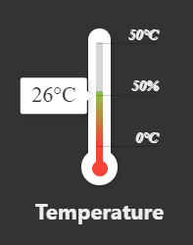
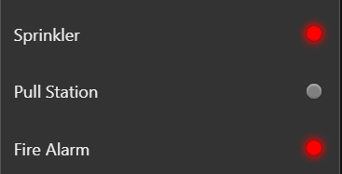
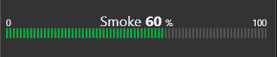
Read Data from MQTT Server and Display System Status on SCADA
Sensor/Actuator statuses on a particular room.
Temperature
Gas/Smoke Level
Sprinkler Status
Fire Alarm Status
Pull Station Status

Slide 20
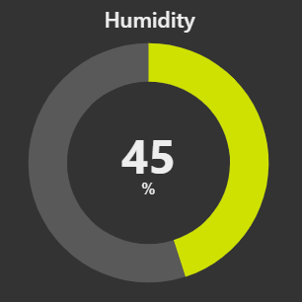
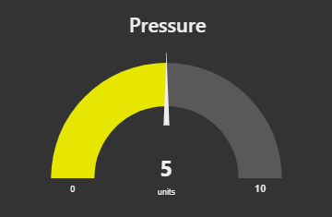
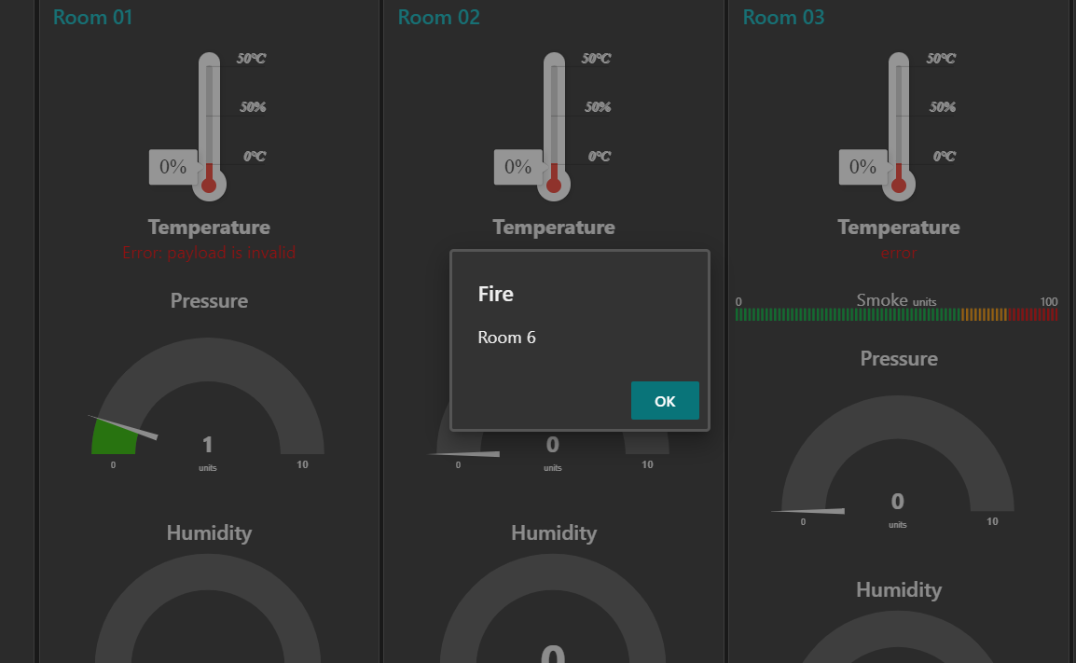
Environmental conditions related to fire
Humidity
Pressure
A notification pops up overlaying the dashboard when fire is detected.

Slide 21
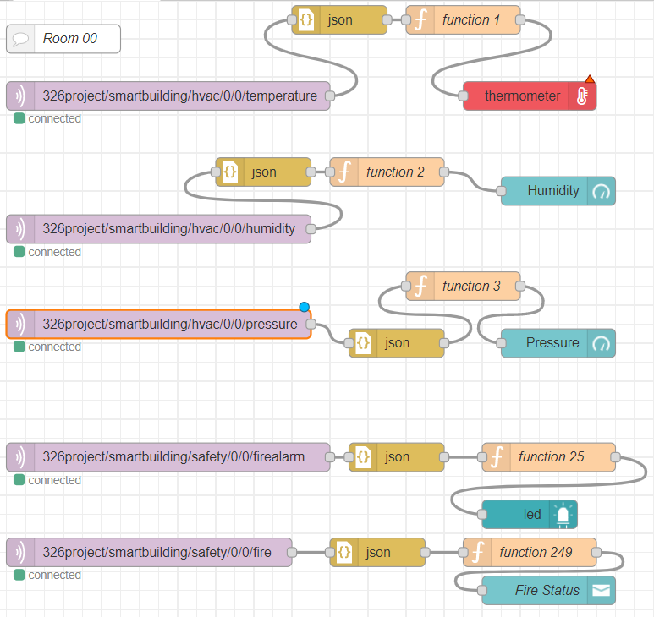

Slide 22
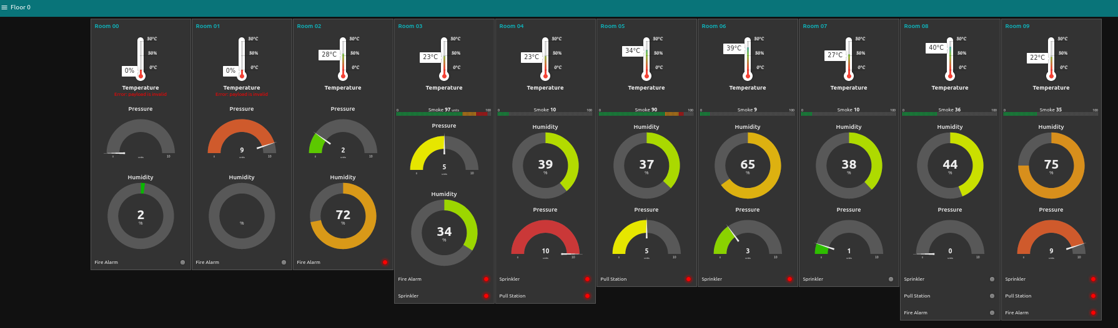
Node Red Dashboard

Slide 23
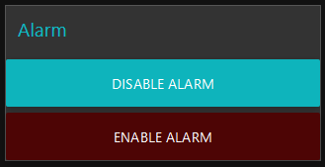
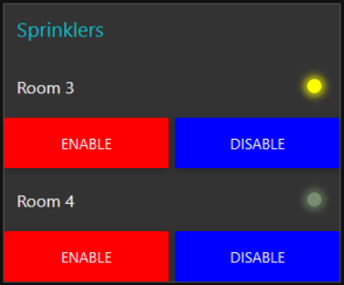
Inputs from the SCADA
Control alarms from SCADA dashboard
Floor by floor
Control sprinklers from SCADA dashboard
Room by room
Indicates current state

Slide 24
Database
Sensor readings and Actuators states are saved in MongoDB.
Old data used for statistical analysis.
Retrieving data to find the safest path.

Slide 25
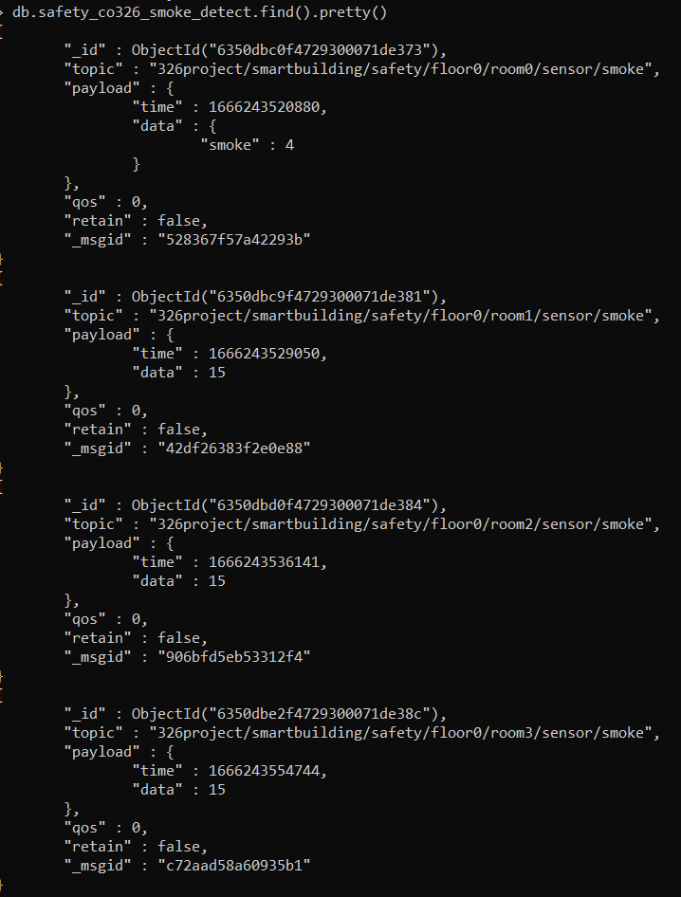
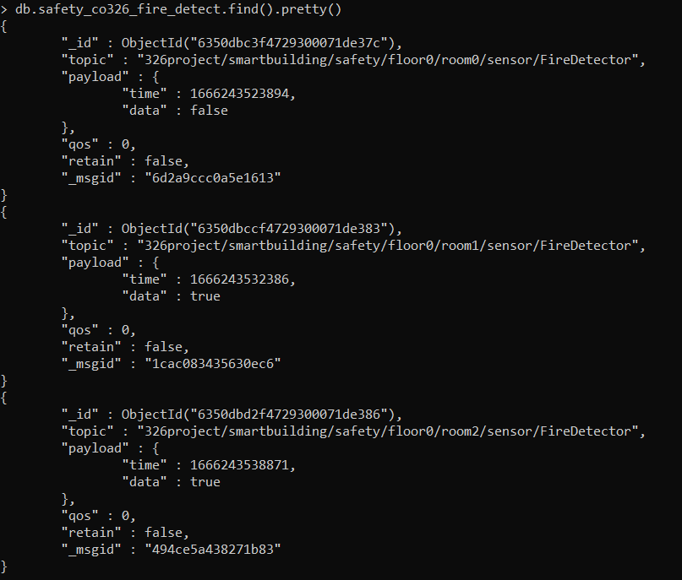

Slide 26
Web interface
Show past data and actions

Slide 27
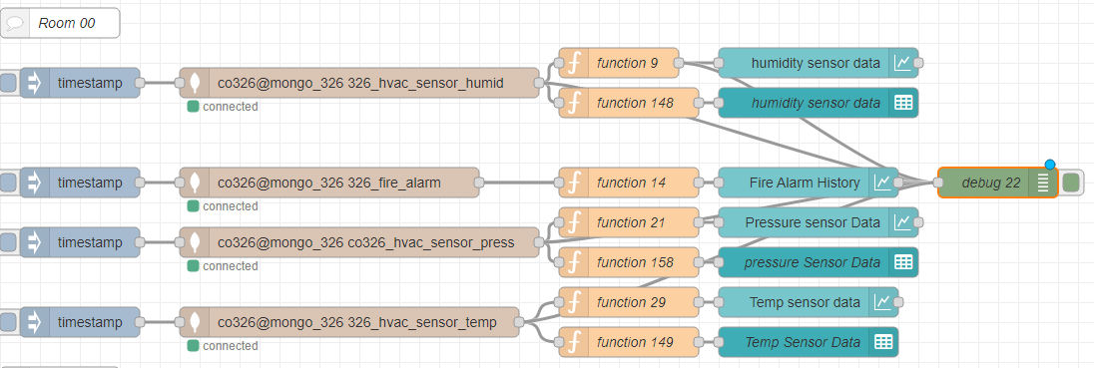
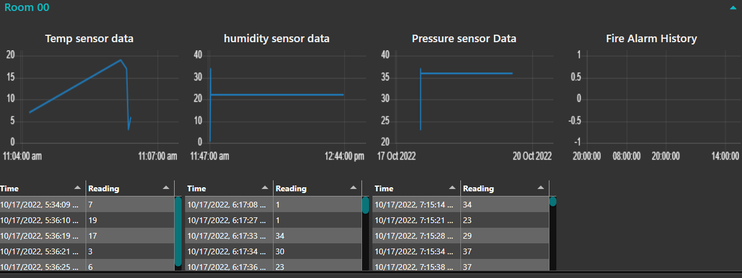
Web Interface
Web interface shows data in the mongoDB database that related to the safety of the building.
Temperature sensor data
Humidity sensor data
Smoke sensor data
Pressure
Fire Alarm state
Sprinkler state
Pull station state
Show all room data separately
Node-red development for Room0 in floor0
Web interface out for Room0 in floor0

Slide 28
Failure handling
Damages in the sensors and wires
Controlling system failure

Slide 29
Failure Handling…
Using fire resistance wires and Sensors setups
Using Pull station for manual activation
Generating alert to fire department
Regular
Inspection
Testing
Maintenance
For make the system in proper condition

Slide 30
Thank you

